Slide 1

Automated Requirements Extraction from Navy Policy Documents
12Jan2026
ENS Logan Garner, ENS Joseph Pusateri, ENS Garrett Hayden

Slide 2
The Operational Problem
Navy policy documents are long, complex, and constantly changing
Requirements for these documents are embedded in technical language and administrative remarks
In the past, reviewing has been slow and inconsistent
This leads to training gaps, overlooking procedures, and an increase in overall risk

Slide 3
Impact Across the Fleet
Training commands
Aviation squadrons
Maintenance and safety programs
Inspections, audits, and readiness reporting
A single missed requirement can become a readiness or safety issue

Slide 4
Manual vs. Automated
Manual | Automated
Human Reading | Machine-assisted extraction
Inconsistent | Standardized Output
Time-intensive | Almost Instantaneous
Hard to audit | Fully Traceable

Slide 5
Automated Requirements Extraction
Ingests Navy policy documents (PDFs)
Identifies explicit requirements statements (shall, must, required)
Outputs structured, searchable, filtered requirements
Preserves traceability to the source document
Policy PDF
AI Extraction
Structured Requirements
Review / Use

Slide 6
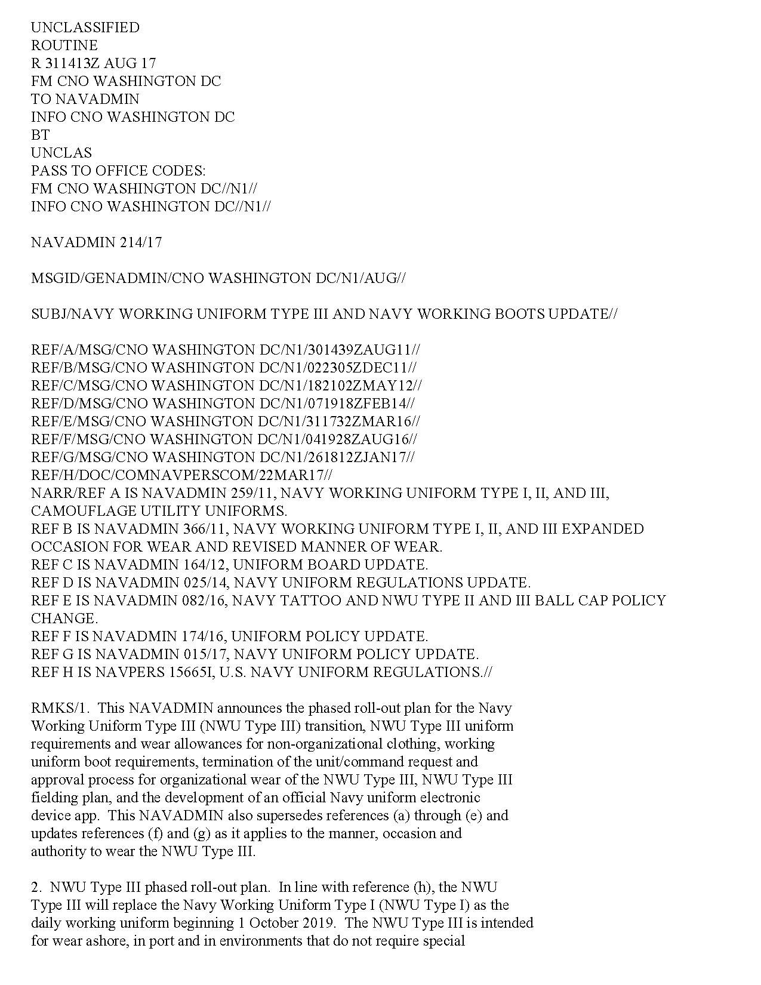
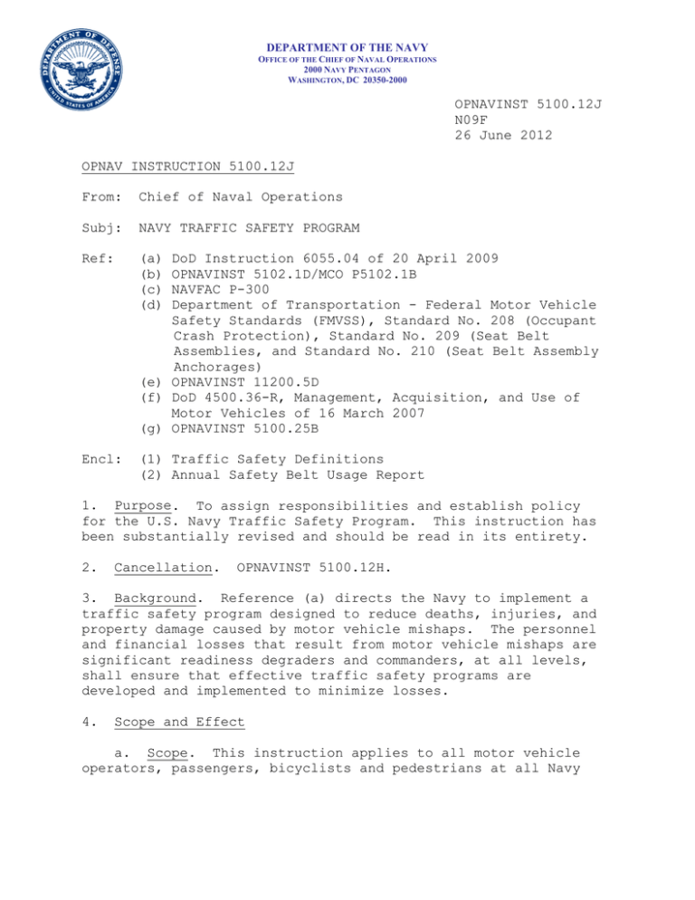
Tailored for the Navy
Focuses on requirements only
Produces machine-readable output
Every requirement links back to the exact source
Designed for Navy-specific language
NAVADMIN
OPNAV Instruction

Slide 7
Technical Overview
Technology Used:
Python - Data Processing and code
Large Language Model - Extraction of requirements from documents
Metadata parsing - Organization of titles, dates, doc IDs
PDF ingestion and parsing - Converts PDFs to readable text for the model
Model Used:
GPT-4: lightweight, cost efficient
Could be upgraded

Slide 8
Demo (1)
Input: Real Navy Policy document
Output: Clean list of requirements in a readable and filtered medium
Time: Seconds to minutes
Reviewer can see real time data about the number of requirements and the model's progress

Slide 9
Demo (2)

Slide 10
Problems We Encountered
Inconsistent policy document formats
Documents vary widely in structure, layout, and wording
Titles, dates, and information are not consistent across different documents
Modalities were not always requirements
Not all modal verbs were true requirements
Scaling could create cost considerations when it comes to the chosen LLM
Scaling requires cost-aware model selection

Slide 11
Scalability and Future Growth
Works across document types*
Can scale to other administrative, paper based tasks
Future teams can continue to refine model and integration with current Navy systems

Slide 12
Questions/Thank you

